Slide 1
LOUDOUN COUNTY ATHLETICS
HOME OF THE CAPTAINS

Slide 2
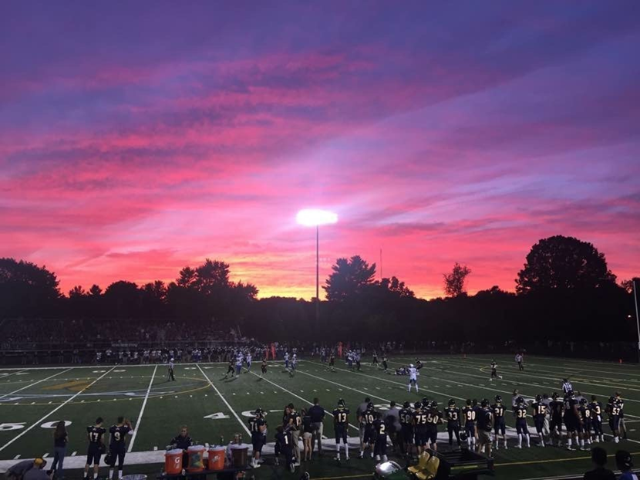
RISING FRESHMAN ATHLETIC ORIENTATION
Athletic Office 571-252-2010
Kate Cassidy, Athletic Director
Kate.Cassidy@lcps.org
Mike Petrella, Assistant Athletic Director
Michael.Petrella@lcps.org
Megan Santos, Athletic Trainer
Megan.Santos@lcps.org
Jordan Nougaret, Associate Athletic Trainer
Jordan.Nougaret@lcps.org
Gary Pitcock, Athletic Custodian

Slide 3
GOAL: PRODUCE PRODUCTIVE ADULTS
- Teach the Love of the Game - Have a Great HS Experience - Life Skills: Teamwork, Sacrifice, Discipline, Self-Advocacy
Winning and Championships Will Take of Itself

Slide 4
WHAT IS THE PURPOSE OF LCHS ATHLETICS?
IS OUR GOAL TO WIN AND HANG BANNERS?
ARE WINS AND LOSSES OUR INDICATORS OF SUCCESS?
4% OF HIGH SCHOOL ATHLETES WILL MOVE ON TO PLAY COLLEGIATELY
2% OF HIGH SCHOOL ATHLETES WILL EARN A SCHOLARSHIP
2% OF COLLEGE ATHLETES WILL PLAY PROFESSIONALLY

Slide 5
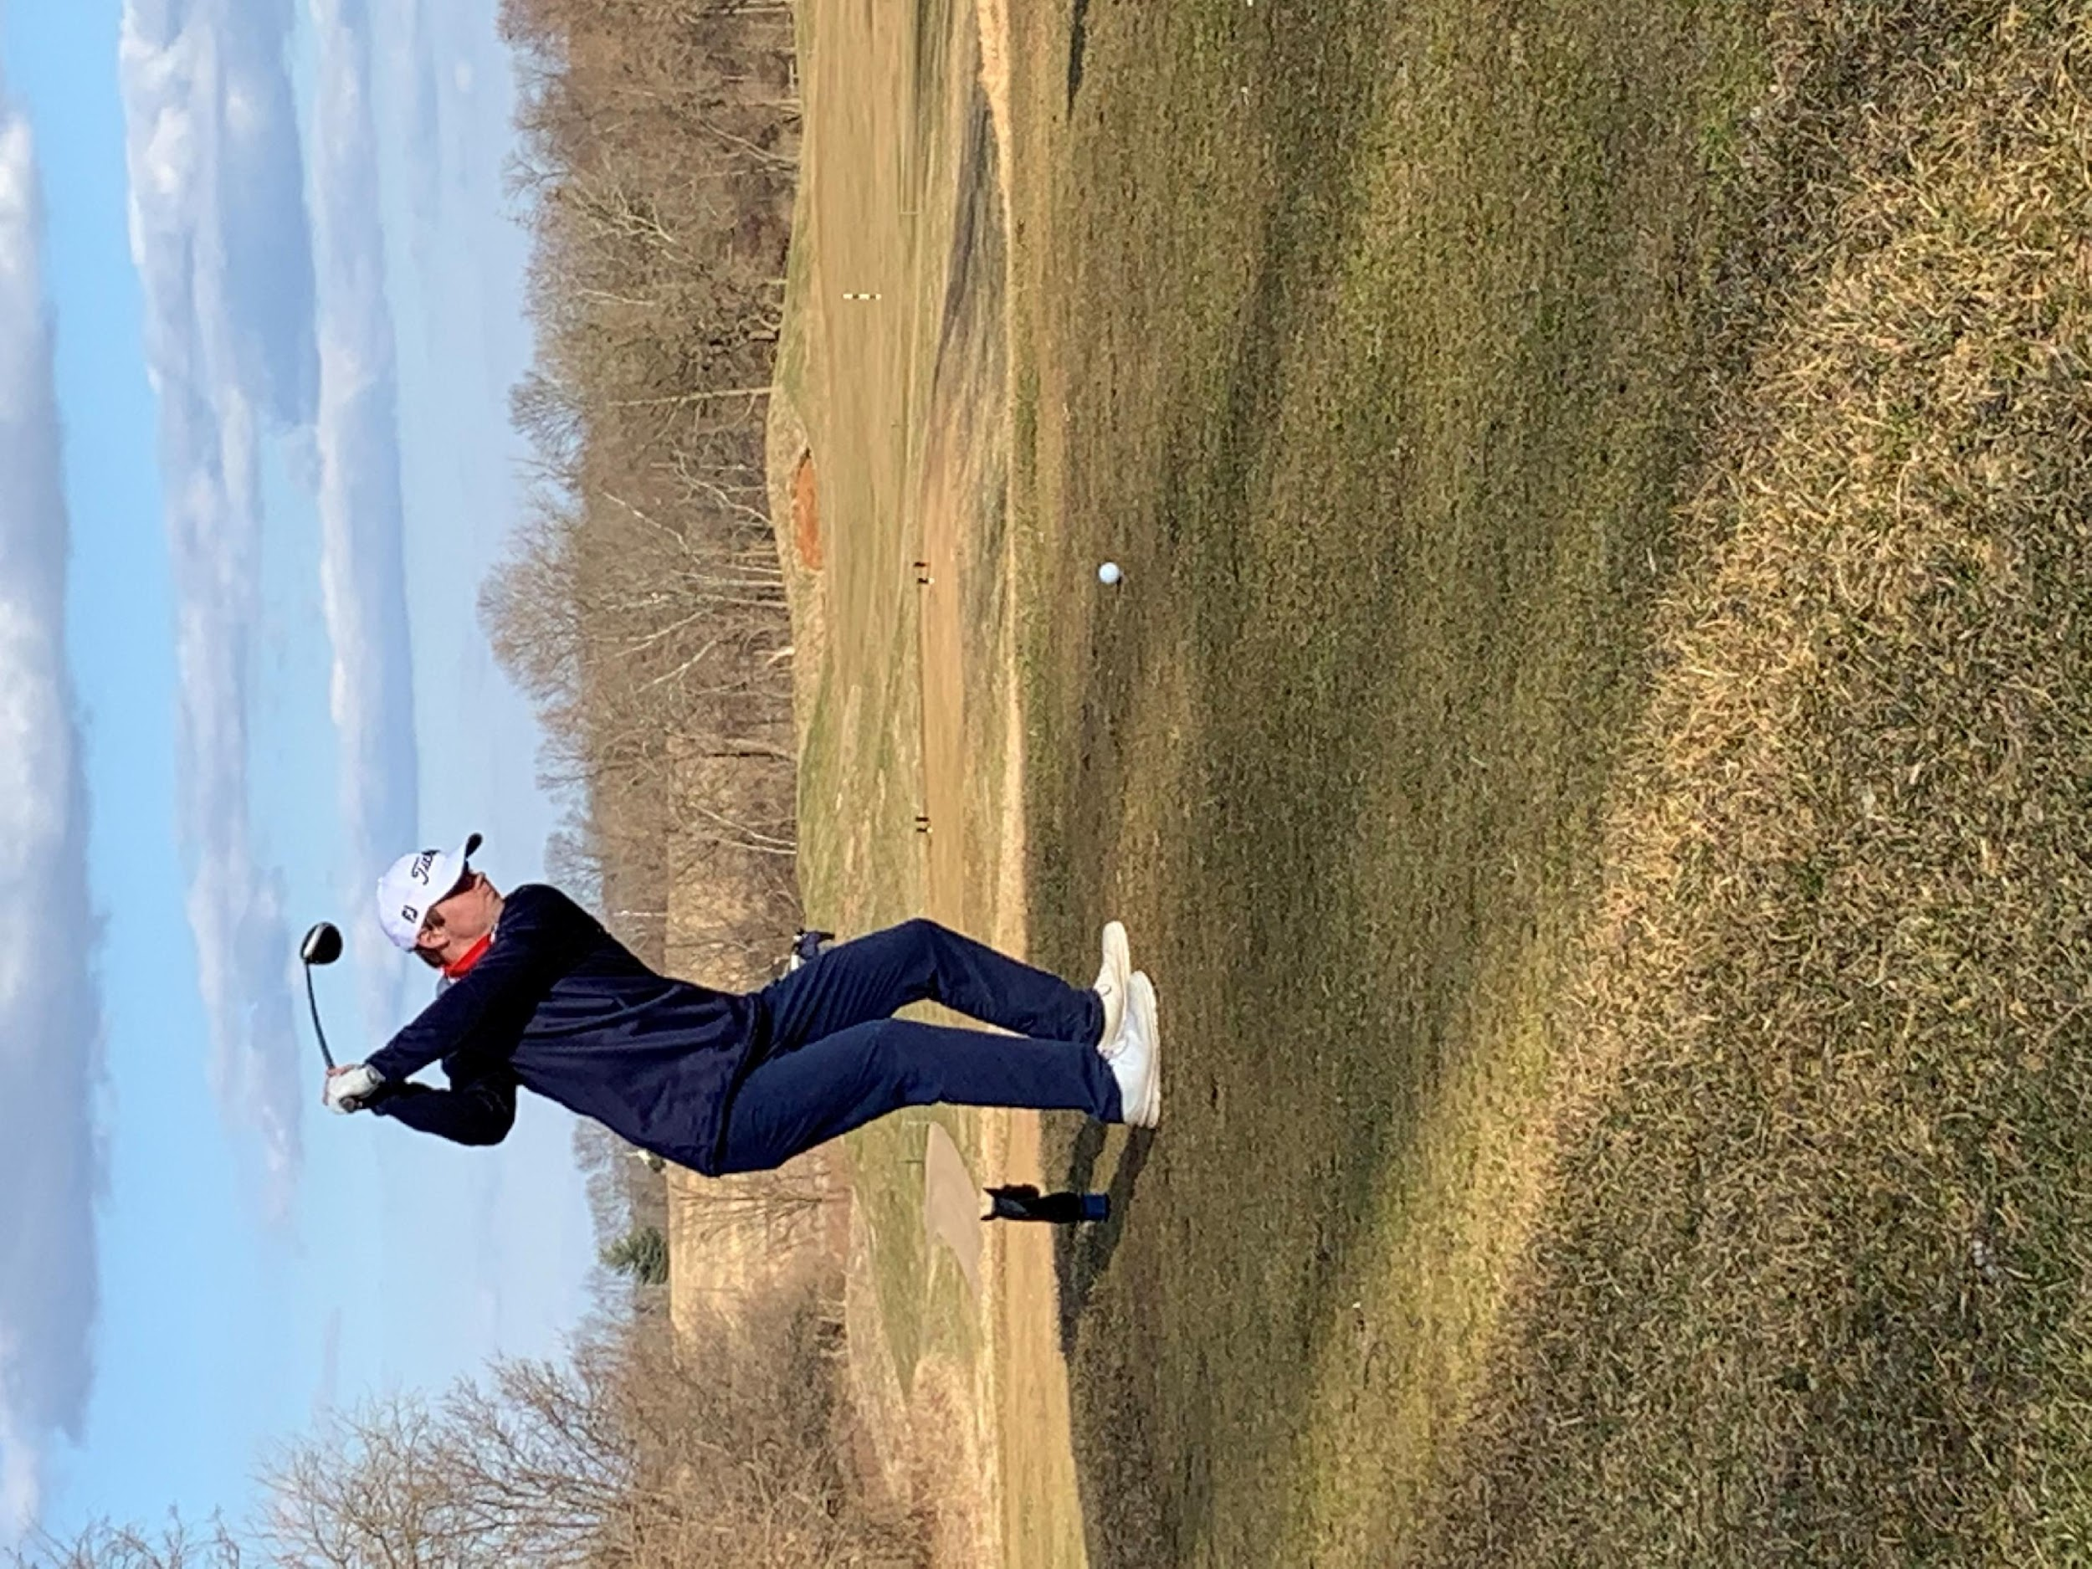
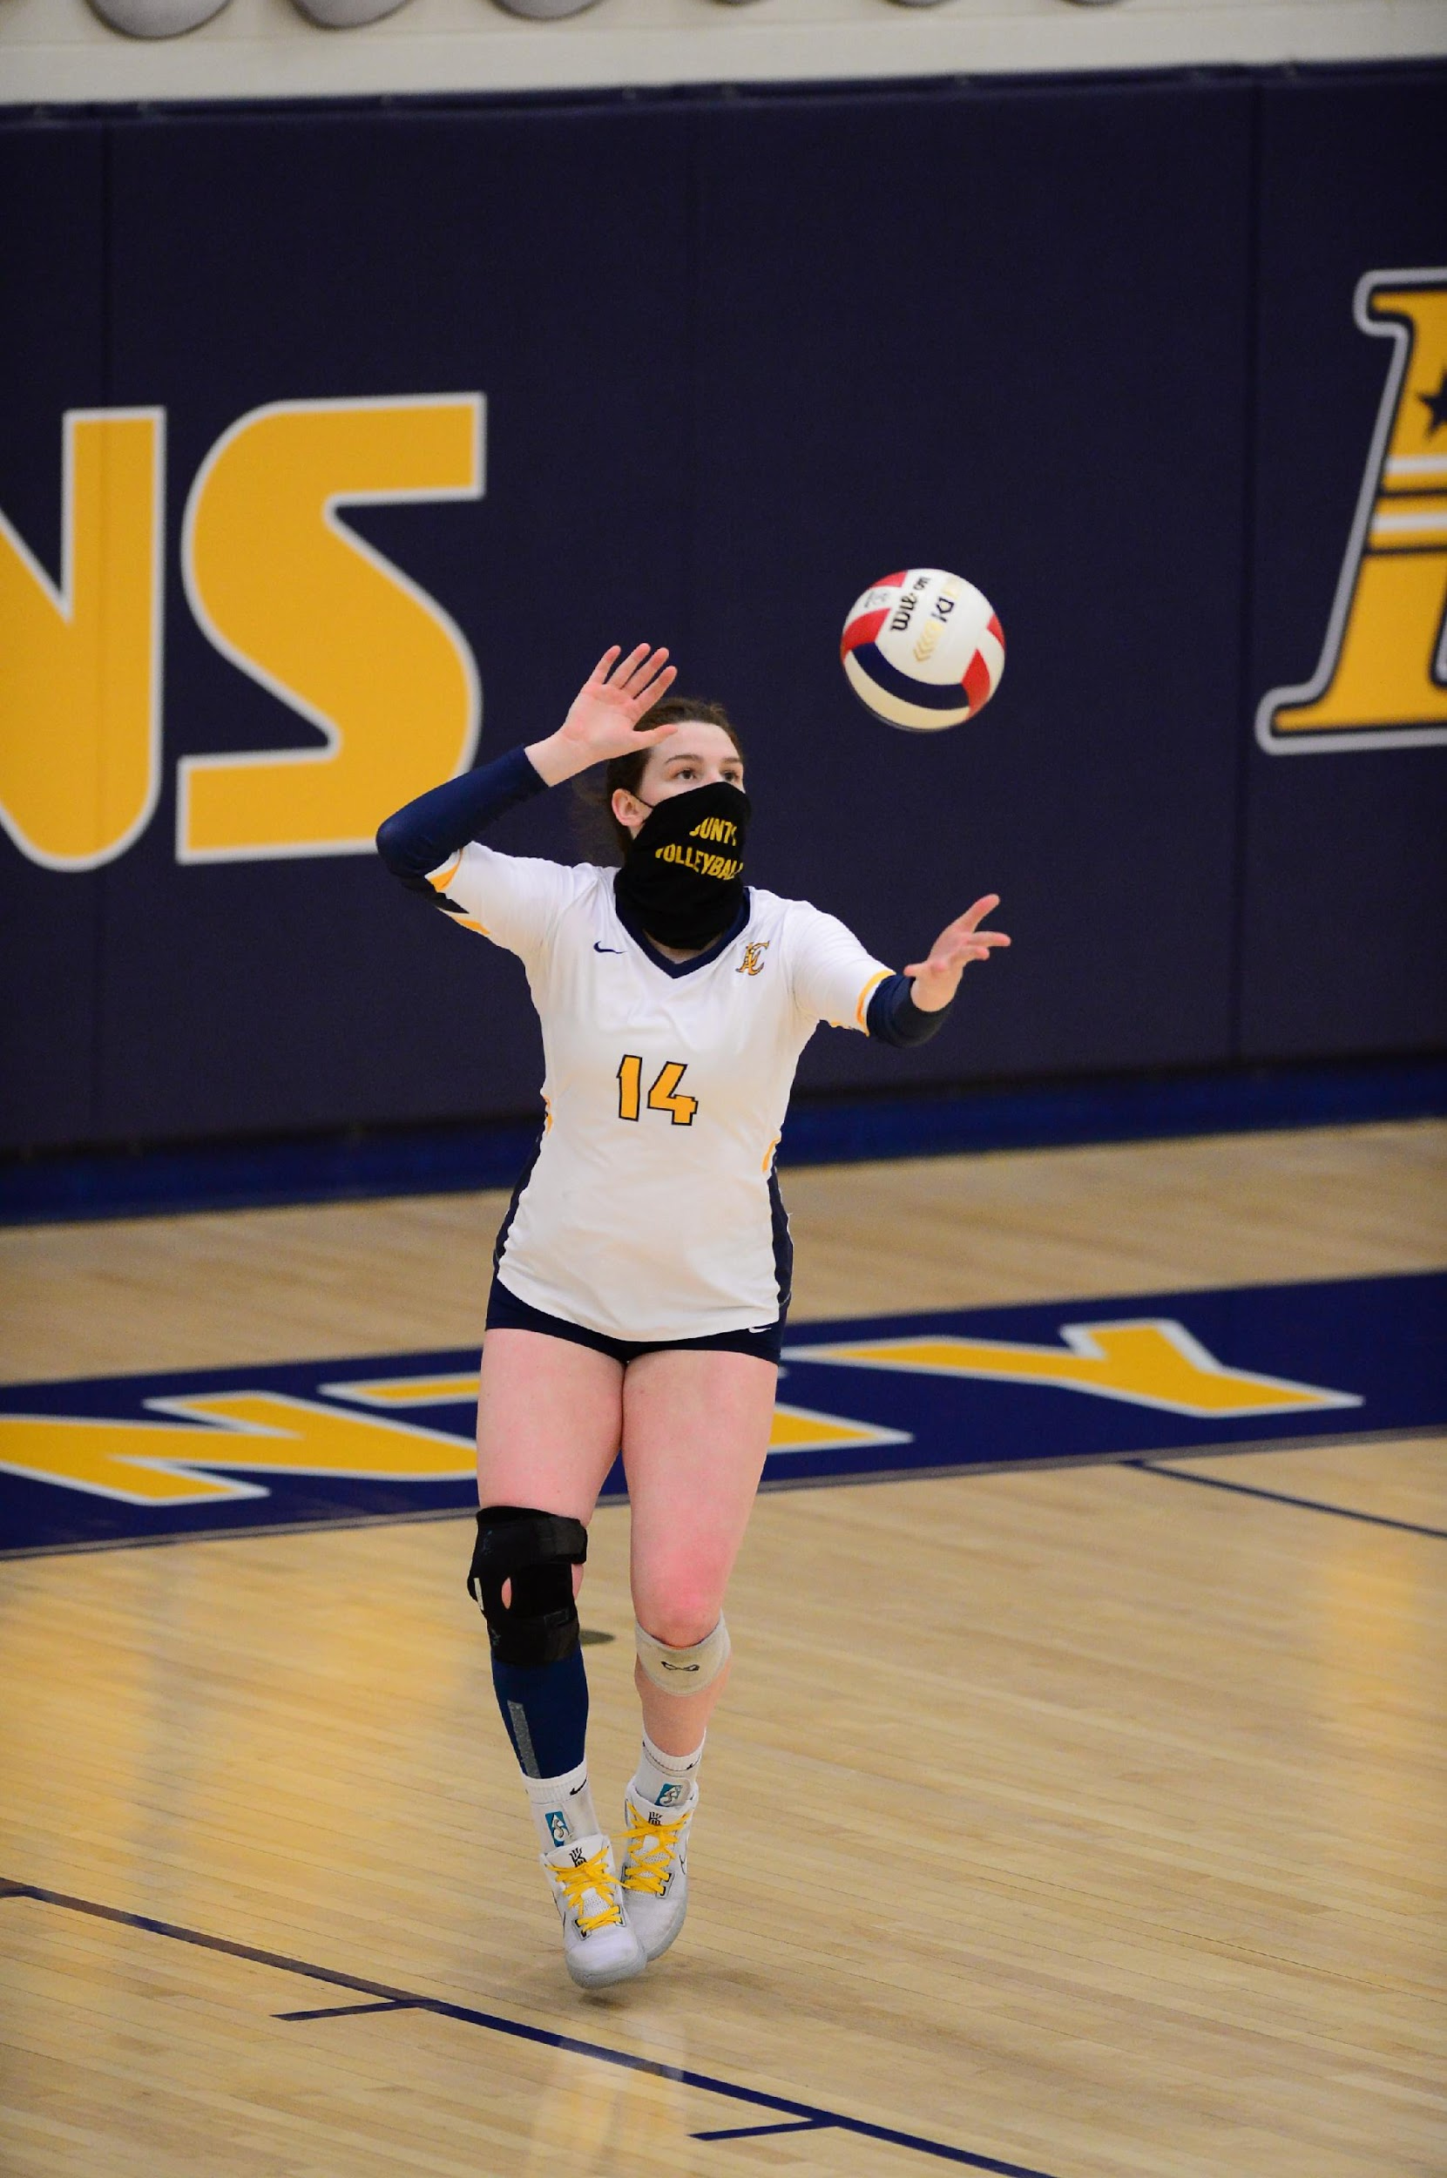
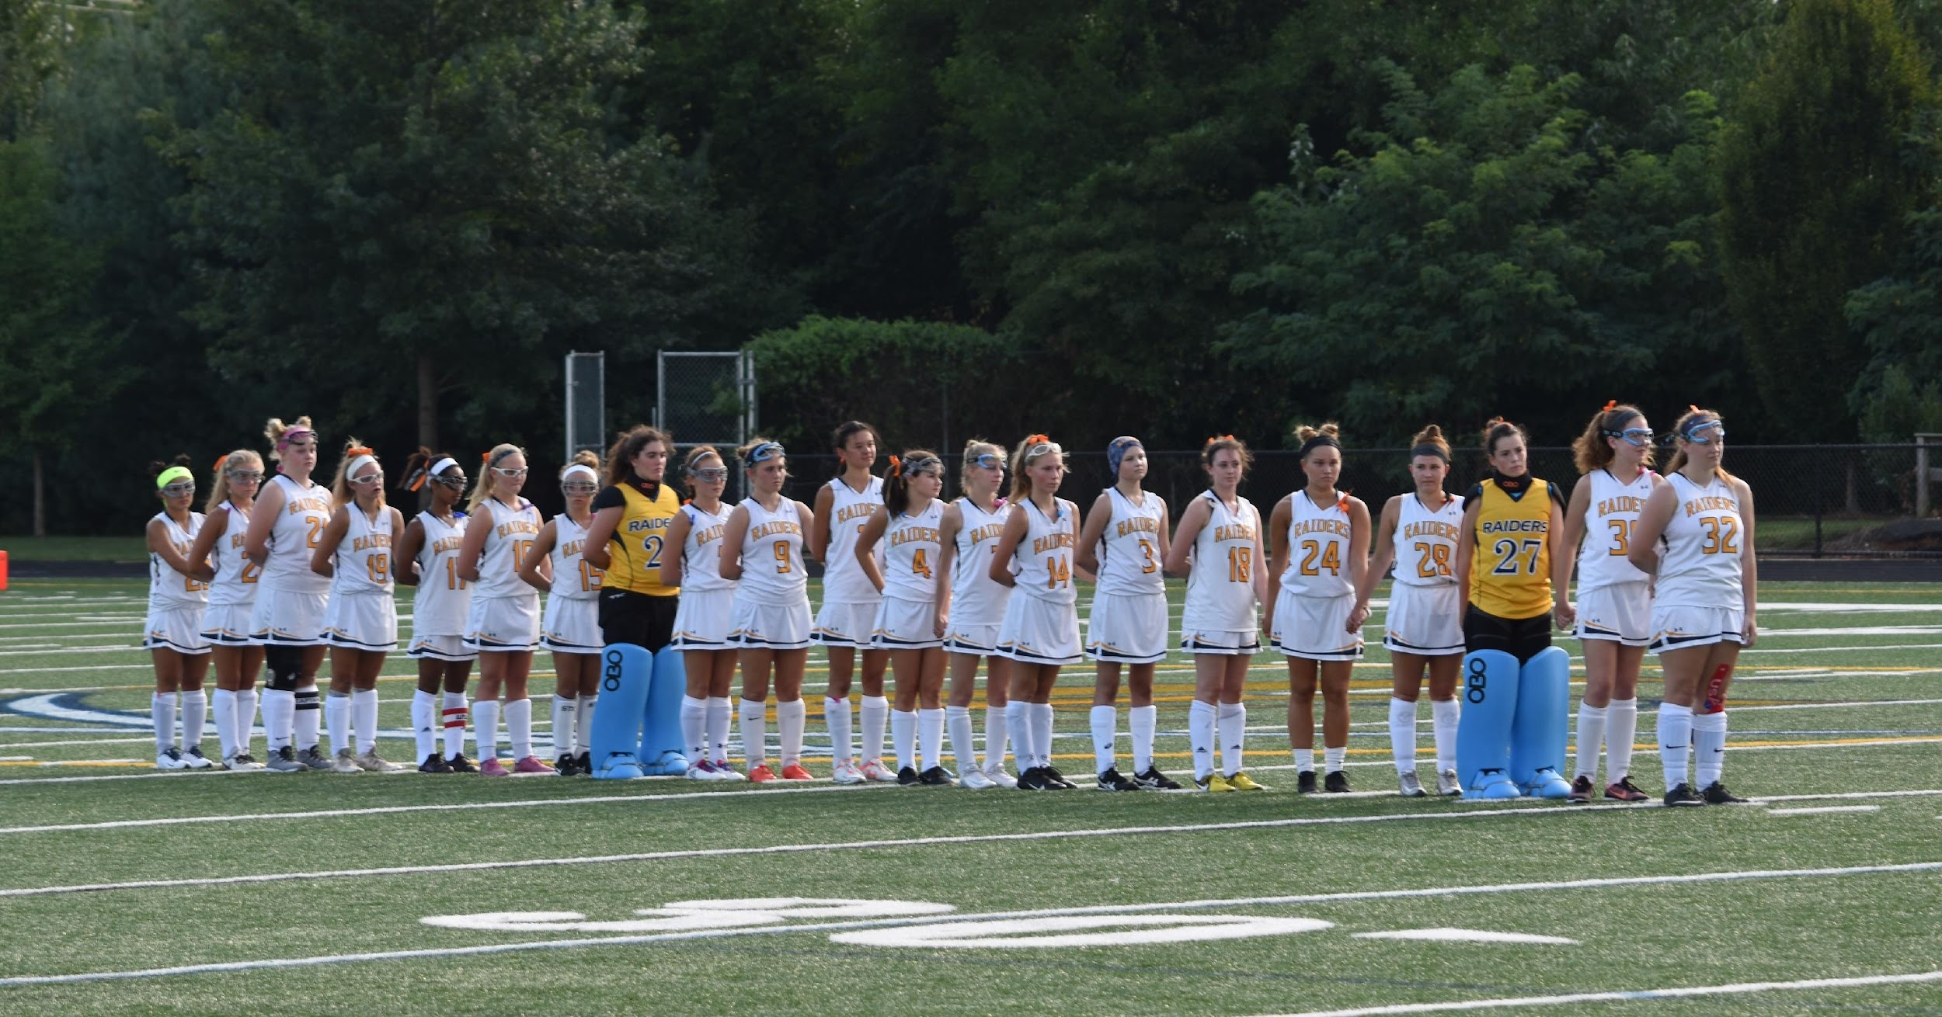
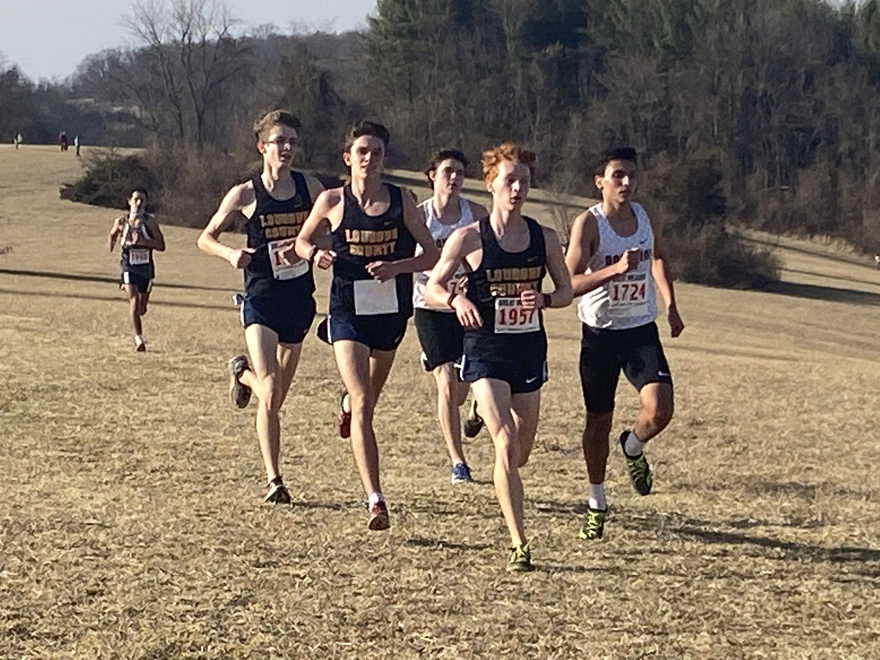
Fall Sports: Tryouts begin on July 31st
Cheerleading – F, JV, V
Cross Country – V
Girls’ Field Hockey – V
Football – F, JV, V
Girls Volleyball – F, JV, V
Golf – V

Slide 6
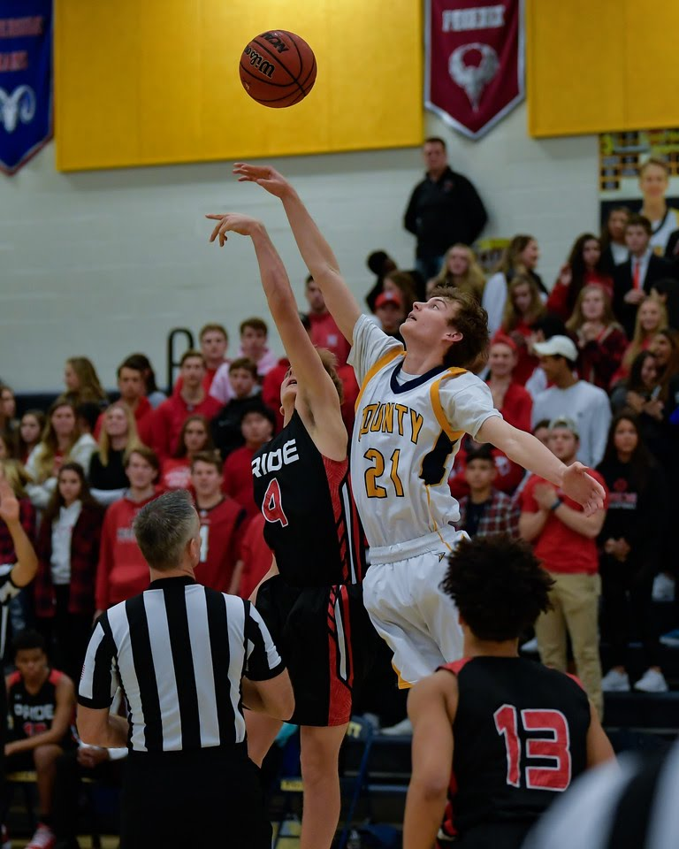
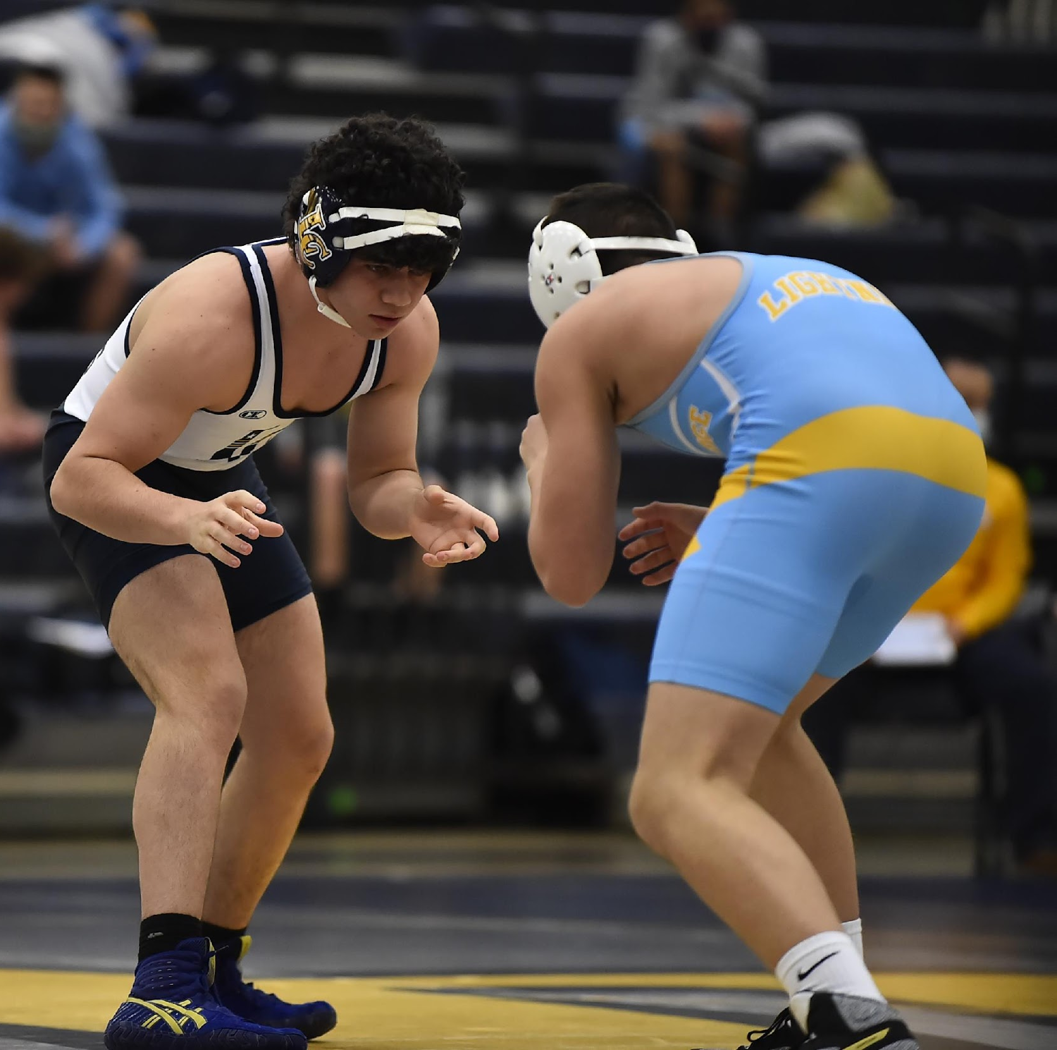
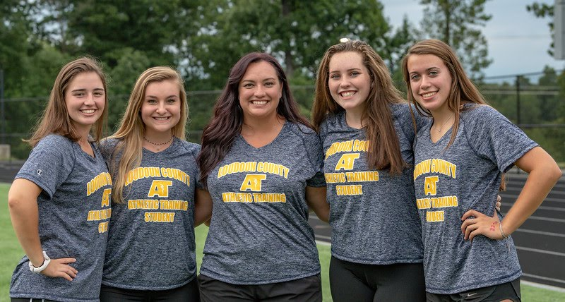
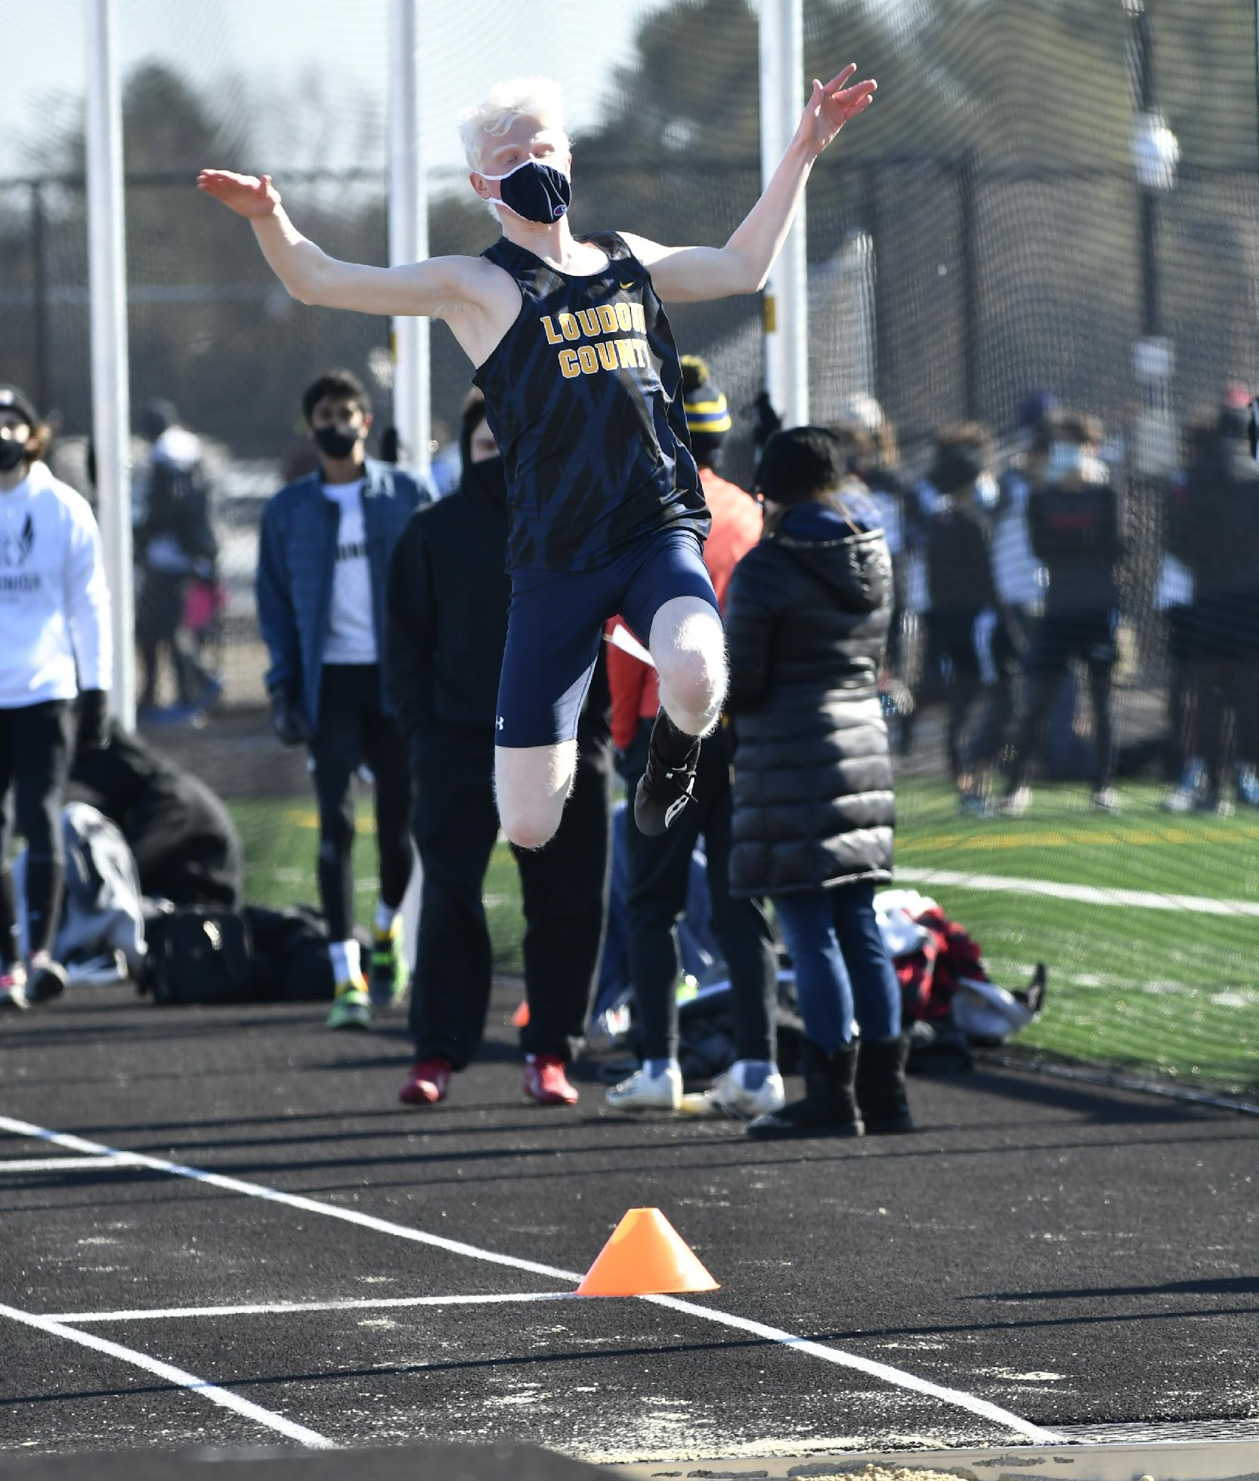
Winter Sports: Nov. 6th
Boys’ and Girls’ Basketball – F, JV, V
Cheerleading – V
Girls’ Gymnastics – V
Boys’ and Girls’ Swimming – V
Wrestling – JV, V
Indoor Track – V

Slide 7
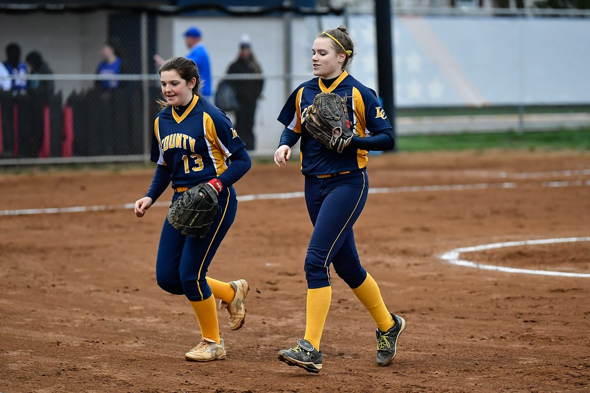
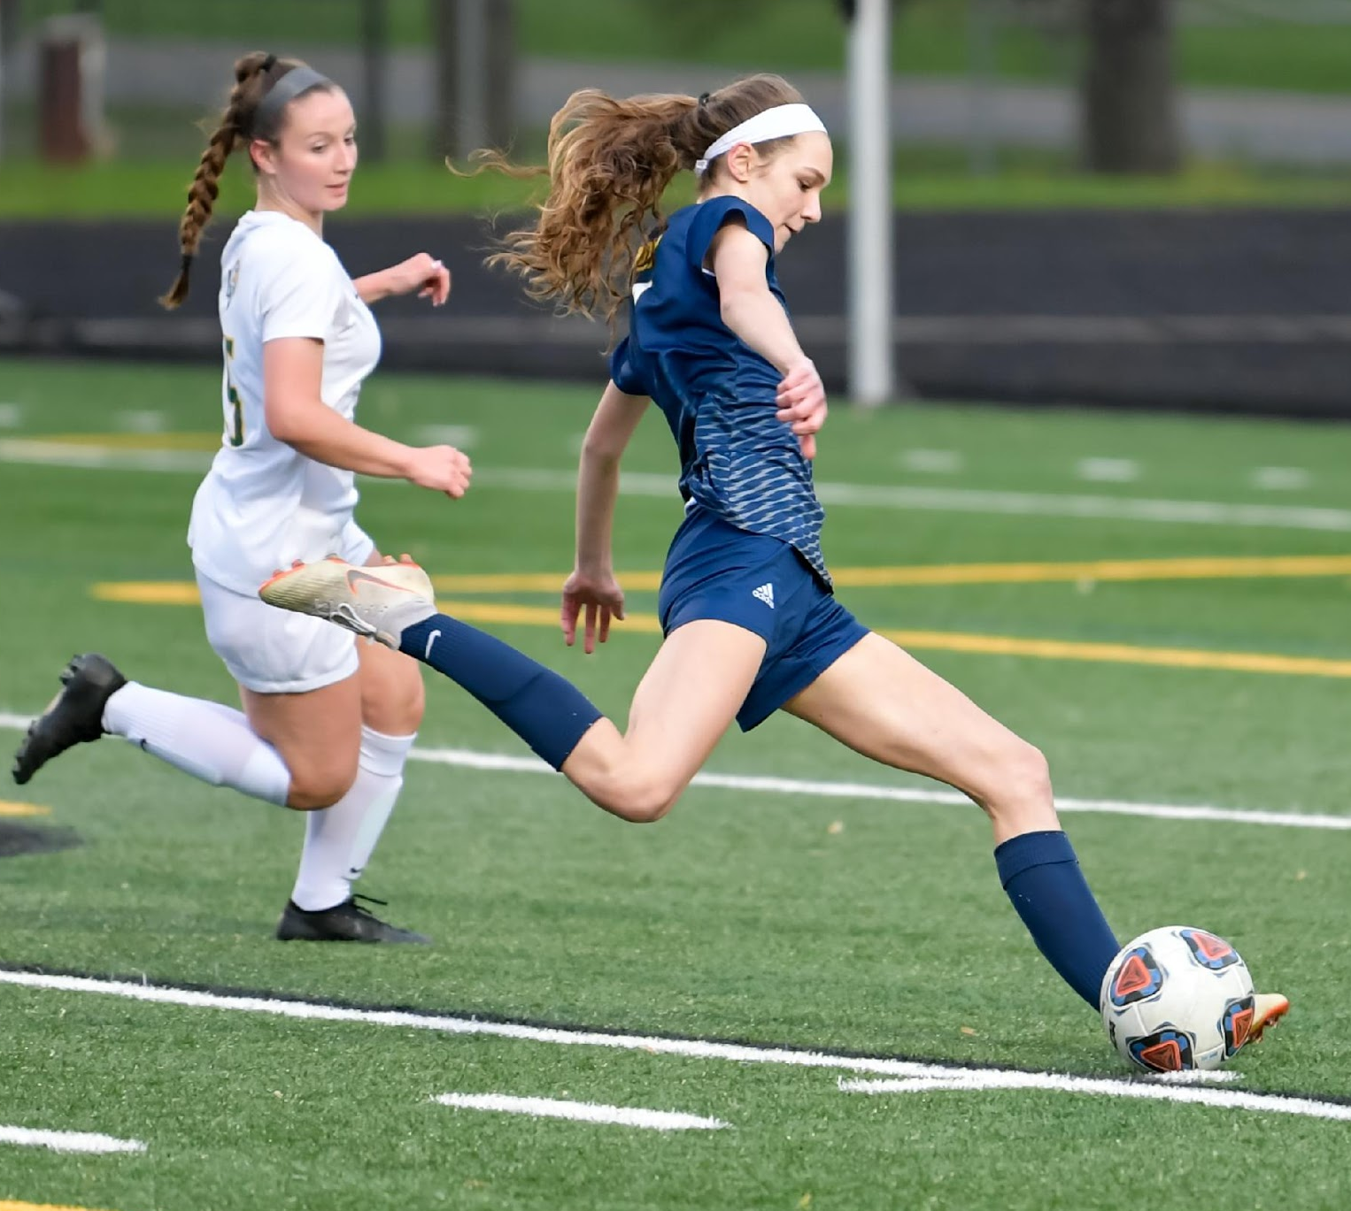
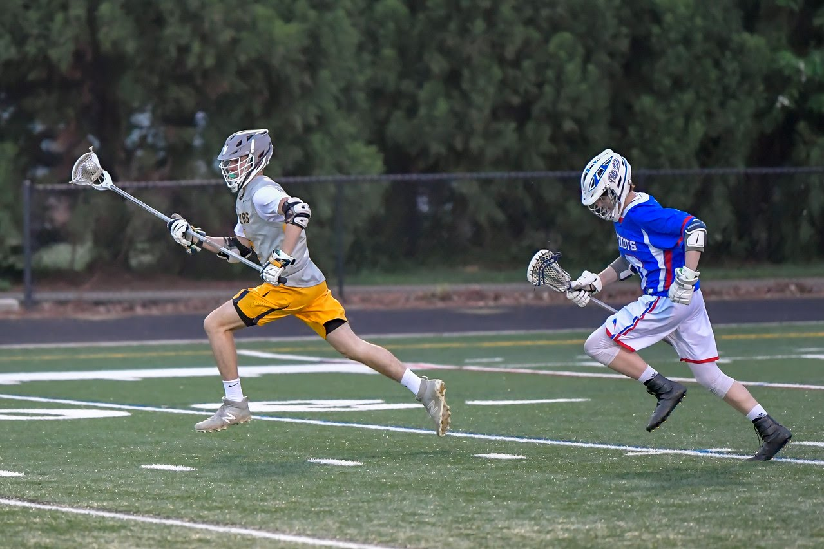
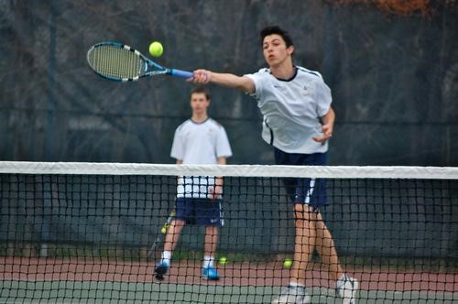
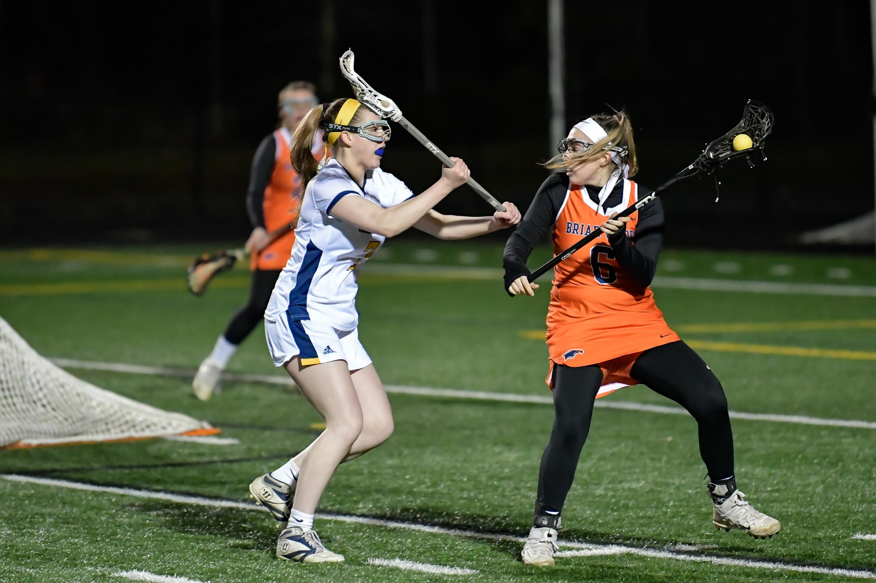
Spring Sports: Tryouts Feb. 19th School Holiday
Baseball – JV, V
Softball – JV, V
Boys’ and Girls’ Lacrosse – JV, V
Boys’ and Girls’ Soccer – JV, V
Boys’ and Girls’ Tennis – V
Boys’ and Girls’ Track and Field – V
Crew - (Tier III Sport –Students are responsible for all fees)

Slide 8
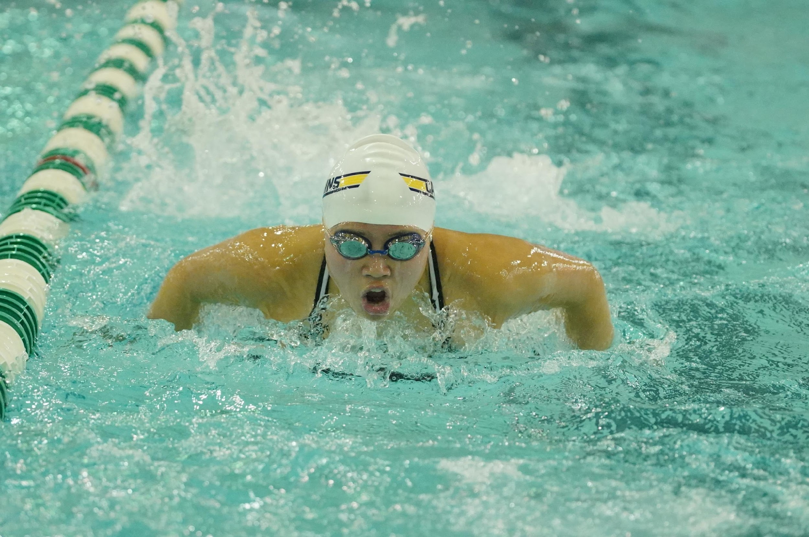
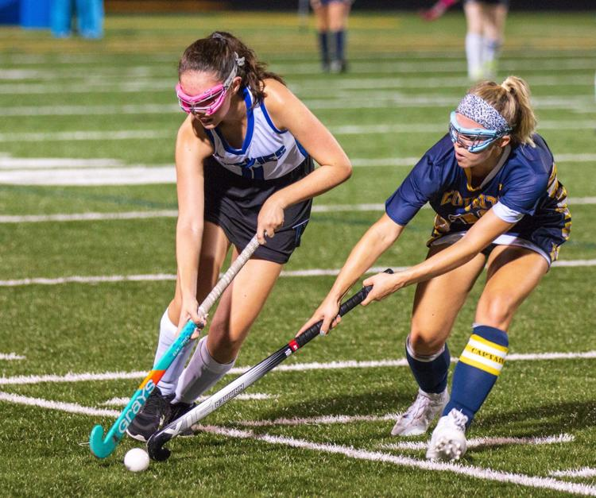
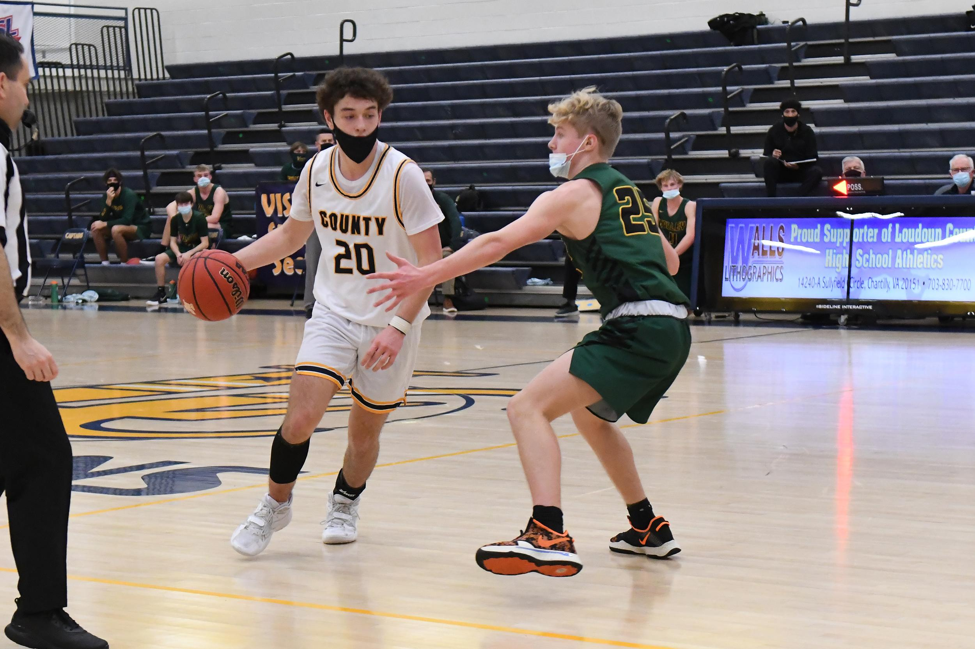
REQUIRED PAPERWORK FOR ATHLETES
VHSL Physical Form – Must be dated after May 1st
Physical should be turned in to athletic office. Do not turn it in to a coach or main office. If you are in ROTC you must turn in a physical to BOTH ROTC and Athletics.
Online Registration – Available after July 1st
Visit www.countysports.info and click on Online Registration.
Follow the steps to register and complete the Training Rules, Consent, Concussion and Emergency Card which will be submitted electronically.

Slide 9
Athletic Fee
Loudoun County Public Schools requires that each student pay a non-refundable athletic fee of $75 for each sport season they play. The fee will be waived for students that qualify for the free or reduced lunch program. Fees will be paid after tryouts once final team selection has been made.
Website and Twitter
Please take a minute to visit www.countysports.info and register by clicking “JOIN” in the top right-hand corner of the page. This section allows you to get email notifications on specific sports.
In addition, the website can be translated into eighty different languages by selecting your desired language in the bottom right-hand corner.
Follow us on twitter @countyLCHS

Slide 10
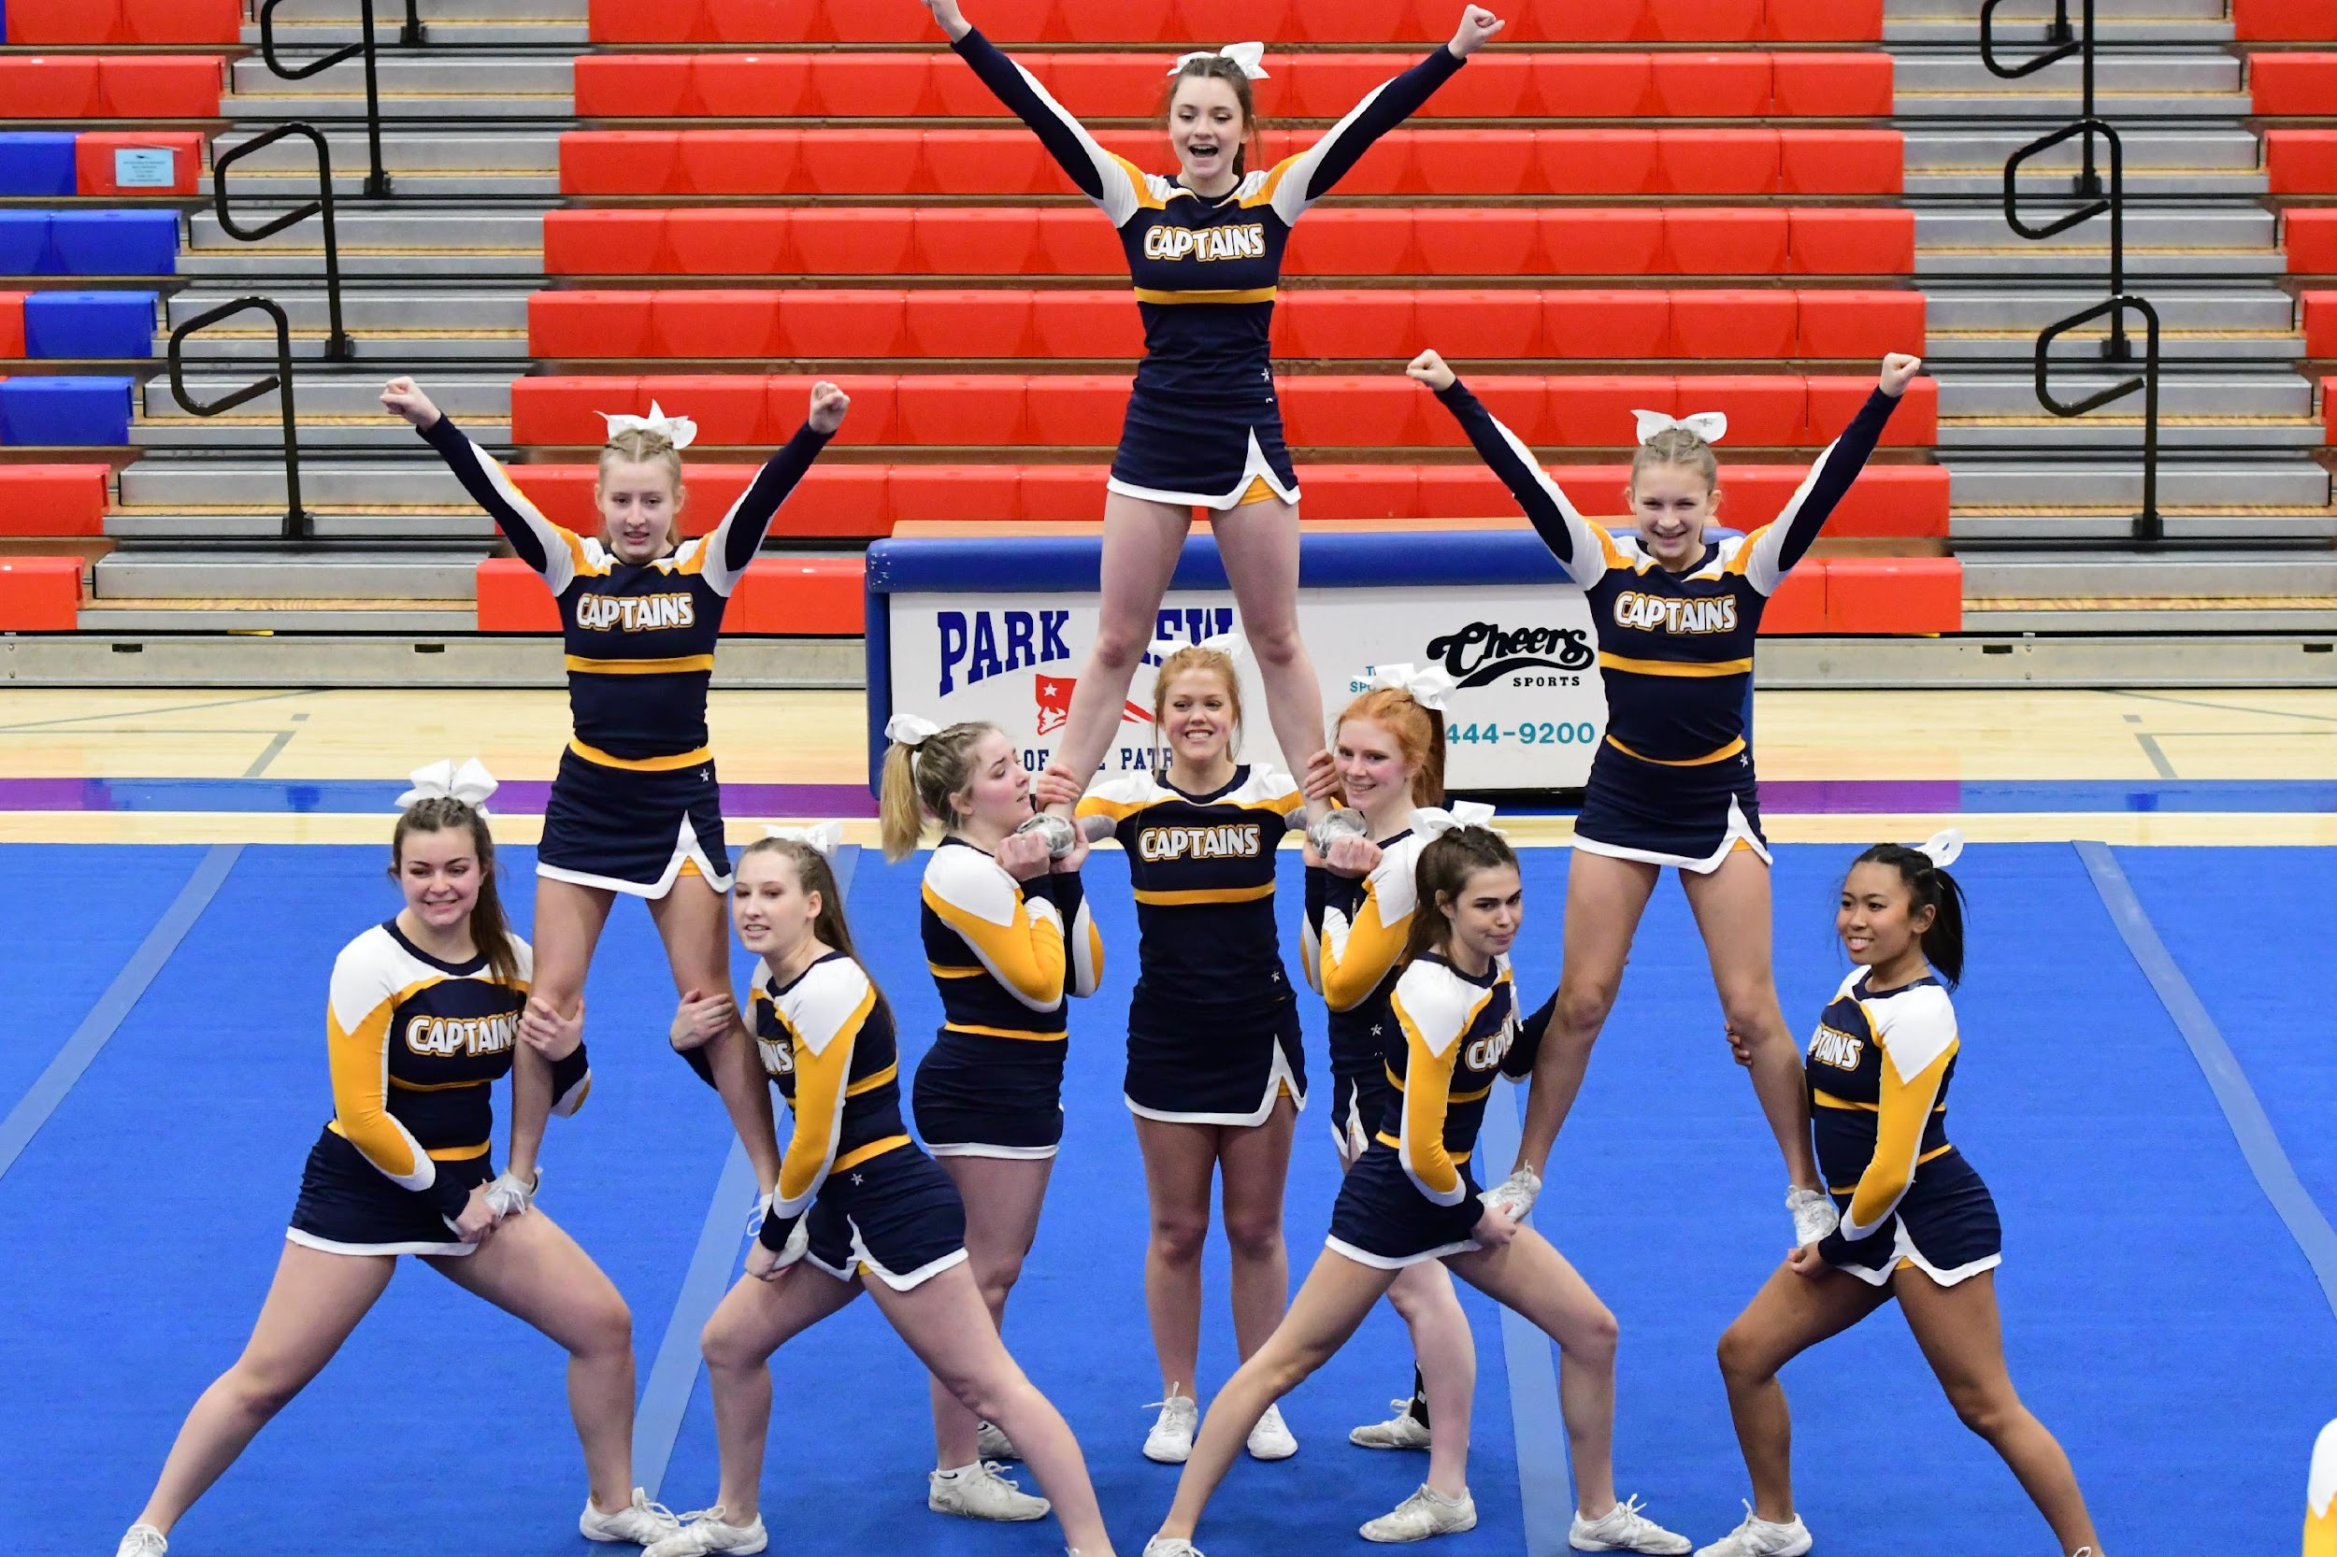
Student Athlete Rules
Eligibility
Students must pass and take a minimum of five courses to be eligible. Eligibility is determined by semester grades at the end of Jan. and Jun. All 9th graders are eligible for the first semester and their grades will be rechecked in Jan.
Vacation Policy
It is the expectation of the athletic department that athletes make a commitment to a team when they tryout. Athletes are required to attend all practices/games. Vacations by athletic team members during a sport season are discouraged and each day missed may be considered an unexcused absence.

Slide 11
STUDENT ATHLETE RULES (CONT)
Attendance/Missing Practices or Games – Training Rule #7
Students are expected to attend practices every day. To practice or play each day a student must report to school by 9:45 am (school starts at 9:30 am) and must remain in school the entire day. Exceptions may be made for doctor or dental appointments and court appearances with proper documentation. An athlete must notify their coach or the athletic department prior to missing practice or a game. At the time of notification, a determination will be made as to whether the absence is excused or unexcused. Unexcused absences 1-3 may result in disciplinary action. On the 4th unexcused absence, an athlete may be dismissed from the team by the athletic director.

Slide 12
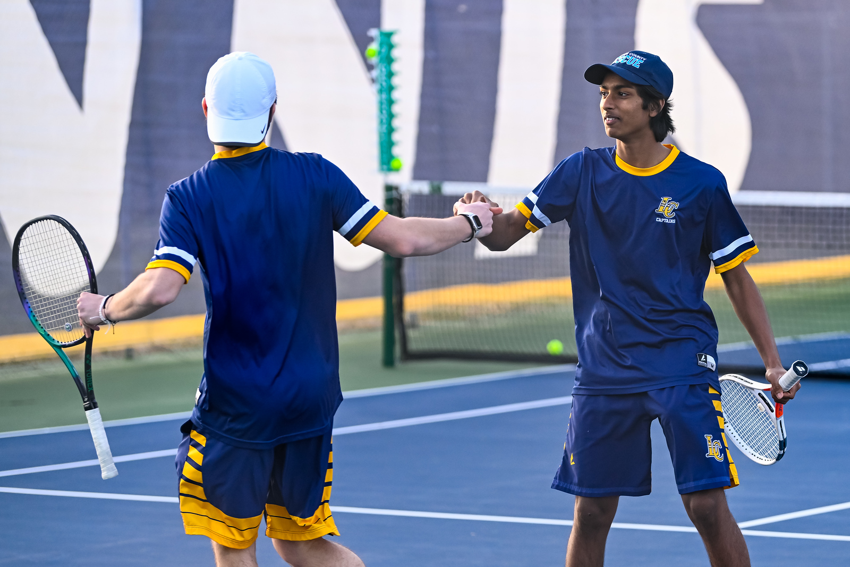
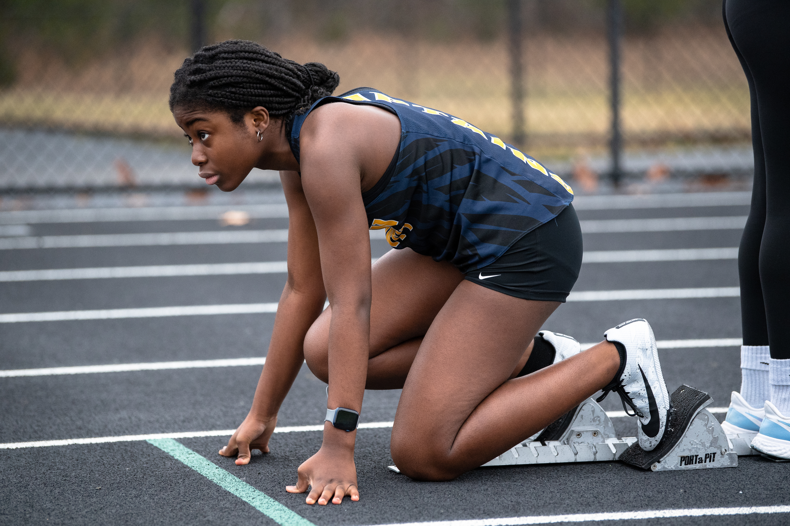
ISR/OSS
Training Rule #8 --ISR/OSS
Any student serving suspension or in-school restriction for violation of school rules will be ineligible to participate in a scheduled event on the day or days he/she is serving the punishment, including Saturdays and Sundays.

Slide 13
Tobacco, Vapes, Drugs, Alcohol
Training Rule # 9 - Any athlete or manager who uses or possesses tobacco, electronic cigarettes, drugs, or alcohol during his or her VHSL athletic career will be ineligible to participate for 30 calendar days in competitions on the first violation. During the 30-day suspension from competitions, the athlete may attend practices and events (not in uniform at competitions) unless the student is suspended from school or otherwise declared ineligible to participate. A second violation would result in a 45-calendar day removal of the athlete from all team events or until the end of the season, whichever is longer. If the 45-calendar day suspension extends into the next sport season, the athlete may still have the opportunity to try out for the next season and will have to serve the remainder of the 45-calendar day suspension after the conclusion of the tryouts. A third violation would result in a 365-day suspension from all VHSL team participation and extracurricular activities. Each incident is cumulative over the athlete’s VHSL athletic career and is not rescinded at the end of each school year.
Also: Steroid use is illegal and carries a two-year ban of athlete.
30 days - 45 days – 365 days

Slide 14
LCPS Out of Season Practice Rules
Out of Season practices are voluntary and cannot be used as part of the tryout process. Participants must have all paperwork (VHSL physical/online registration) completed before attending. Participants consist of 9th-12th graders and 8th graders once they are promoted to high school after the last day of their 8th grade year.
2023: On or after June 8, 2023
Each sport may have 20 out of season practices each off season (fall, winter, spring).
Each sport may have 15 out of season practices during the summer.
Summer Dead Period: JULY 2-8, 2023 During dead periods, there may be no coaching, observing or contact between a coach and player. In addition, there may be no practice, open facilities, weight training, conditioning or school sponsored clinics or camps.

Slide 15
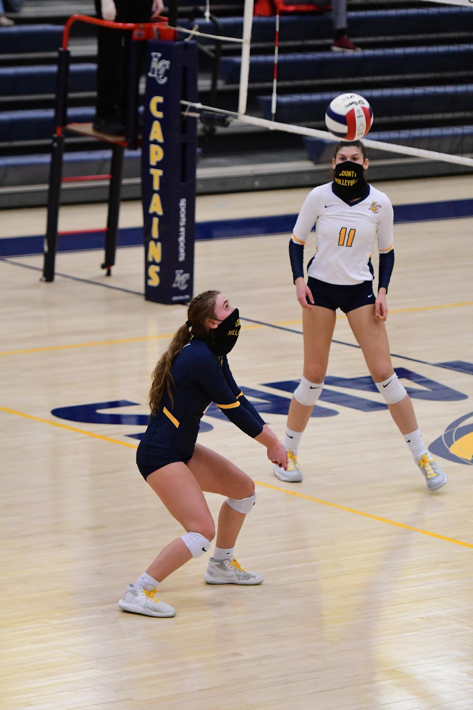
LCHS competes in the Dulles District, Region 4C, 4A State
Dulles District Schools for 2023
Broad Run HS
John Champe HS
Loudoun County HS
Park View HS
Woodgrove
Region 4C
Dulles District Plus Dominion, Heritage, Loudoun Valley, Rock Ridge, and Tuscarora

Slide 16
Athletic Trainer – Megan Santos ATC
Primary Goal : Protect the health, safety, and well-being of your student athletes
On campus for most practices and all competitions
Provide acute emergency care, evaluation of injuries (acute and chronic), rehabilitation of injuries, provide referral if needed, give injury prevention tips
Work to get your student athlete back to participation as quickly and safely as possible
Work through concussion return to play and return to learn protocols

Slide 17
Athletic Training Room
Encourage your student athlete to report all injuries, illnesses, wounds right away
If your student athlete has special needs- please report and I can hold on to EXTRA equipment such as:
Contacts
EpiPens
Inhalers
Glucose
Please communicate and ask questions if you have them

Slide 18
Established in 2005
Spent $1.4M
$75 Athletic Fee
Stadium Landscaping
$6,000
Concessions Profit $10,000
Annual Social Fundraiser $6,000
GameTime Music System $3,000
Varsity Letters, Pins, Certificates
$4,000
Concessions Maintenance $5,000
Uniform
Replacement
$30,000/year
Hall of Fame Wall
$6,100
Memberships
179 (out of ~700)
$6,265
Corporate Sponsorships
$15-20,000
Gym Hallway
$4,800
Coaches Clinics $2,000/year
Scholarships
$2,000/year

Slide 19
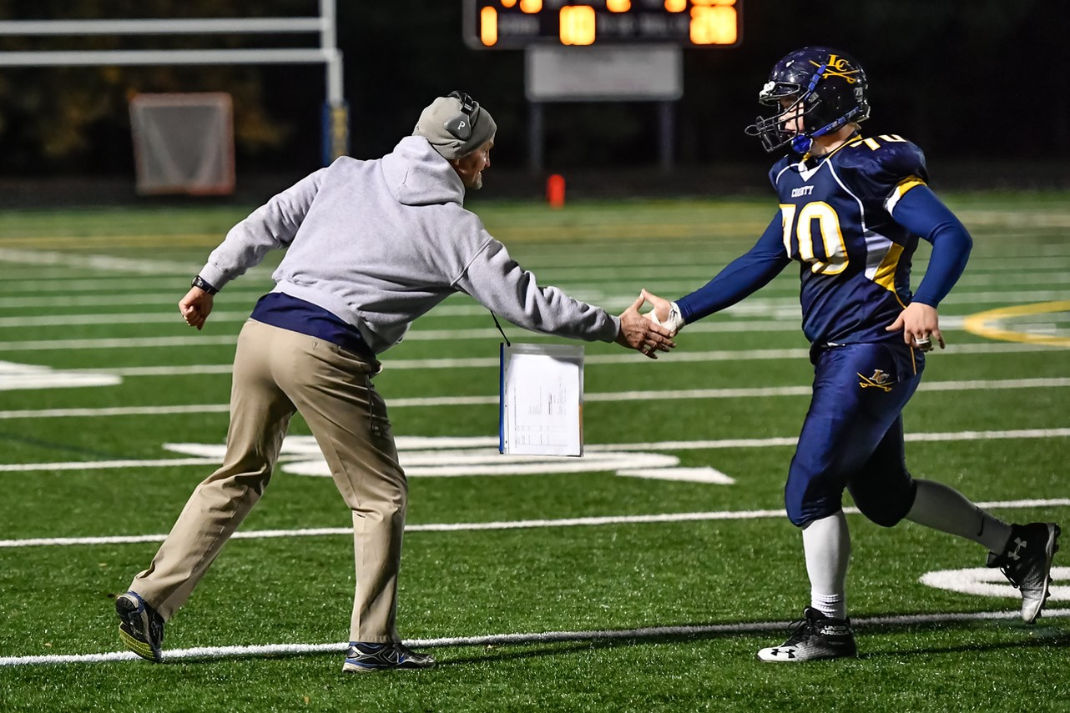
Head Fall Coaches
Football – Matt Reidenbaugh
Matthew.Reidenbaugh@lcps.org
Cross Country – Courtney Campbell
Courtney.Campbell@lcps.org
Volleyball – Sarah Mozeyko
Sarah.Mozeyko@gmail.com
Golf – Mark Alexander
Mark.e.alexander@lcps.org
Cheer – Sam Mancini
Samantha.Mancini@lcps.org
Field Hockey – Maggie Darby
margaret.darby@lcps.org
Head Spring Coaches
Baseball – Matt Landers
Matthew.landers@lcps.org
Softball – Richard Sullivan
Richard.Sullivan@lcps.org
Girls’ Soccer – Tim Lucas
Timothy.Lucas@lcps.org
Boys’ Soccer – Chris Mazzatenta
cmazzatent@aol.com
Boys’ Lacrosse – Dave Colangelo
dwcolangelo@gmail.com
Girls’ Lacrosse – Devon Cunningham
devonmariecunningham@gmail.com
Boys’ Tennis – Schuyler Henderson
Schuyler.Henderson@lcps.org
Girls’ Tennis – Kate Putt
Kateputt@yahoo.com
Boys’ Outdoor T/F – Courtney Campbell
Courtney.Campbell@lcps.org
Girls’ Outdoor T/F – Jamie Carr
James.carr@lcps.org
Crew – Cindy Johnson
lchcrewcoach@gmail.com
Head Winter Coaches
Boys’ Basketball – Mark Alexander
Mark.e.alexander@lcps.org
Girls’ Basketball – Stephane Longchamp
Christian.Longchamp@lcps.org
Cheer – Paige.Illig@lcps.org
Wrestling- Kent Nagy
Matt.Murphy@lcps.org
Swimming – Jay Wareham
Jay.Wareham@lcps.org
Gymnastics – Blake42@vt.edu
Indoor Track – Courtney Campbell
Courtney.Campbell@lcps.org

